Slide 1
GENED 1079 Section 5
Week of October 13, 2026

Slide 2
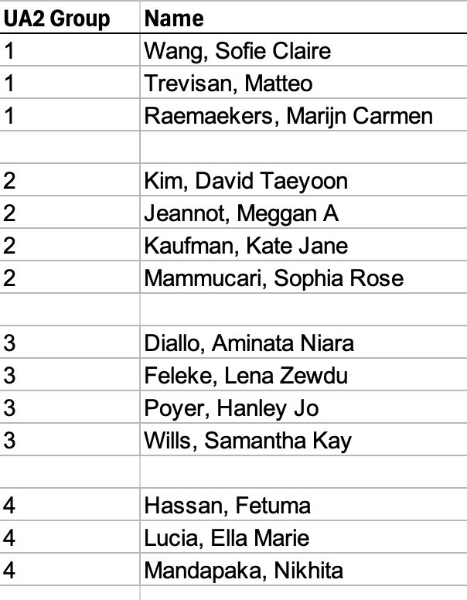

Slide 3
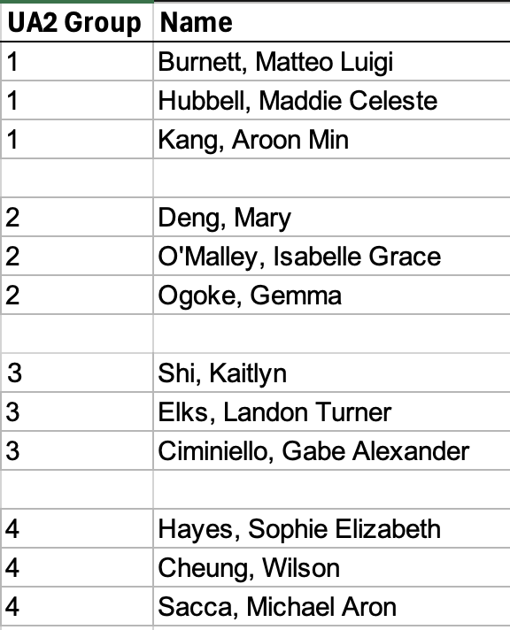

Slide 4
Agenda
Intro: Sickle Cell Disease and Cell and Gene Therapies (15 min)
Group Exercise: Decide how your state will allocate gene therapies for people with Medicaid (20 min)
Presentations & discussion (35 min)
Access to therapies in low-resource settings / low and middle-income countries (5 min)

Slide 5
Agenda
Intro: Sickle Cell Disease and Cell and Gene Therapies
Group Exercise: Decide how your state will allocate gene therapies for people with Medicaid
Presentations & discussion
Access to therapies in low-resource settings / low and middle-income countries
Notes:
12-12:15
1:30-1:45

Slide 6
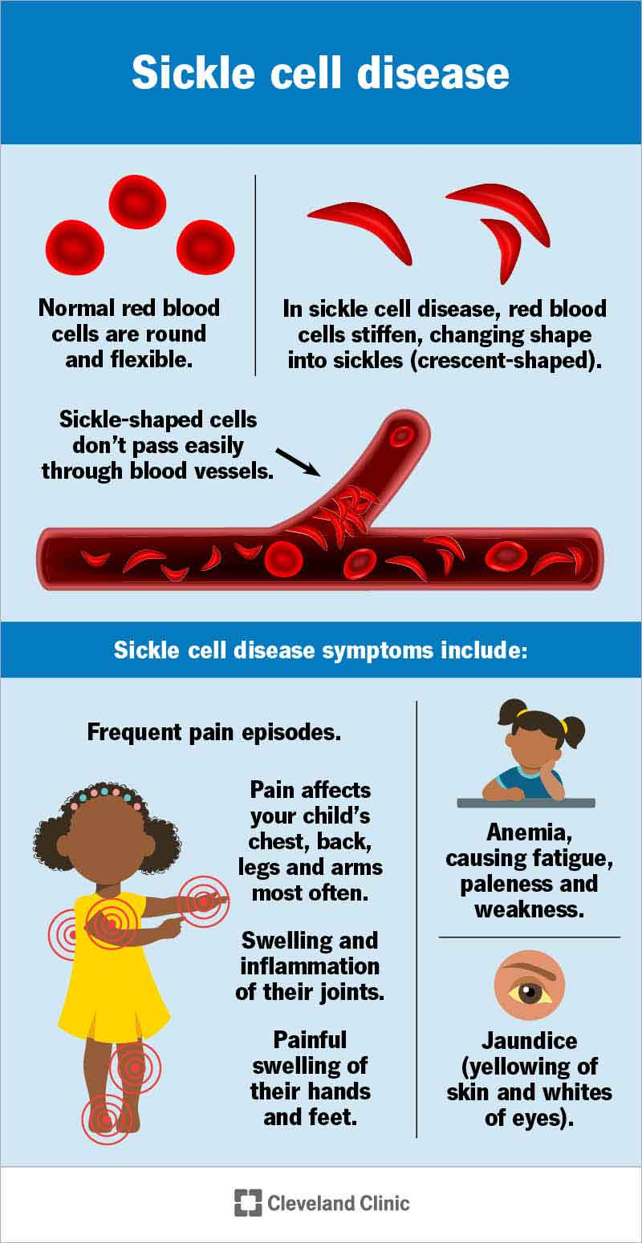
What is sickle cell disease (SCD)?
Genetic blood disorder that causes some blood cells to be stiff and sickle-shaped. These blood cells can clump together, preventing oxygen flow through the body.¹
Major symptoms include chronic and acute pain (including severe pain episodes that require ED/hospitalization), fatigue, strokes, and organ disease.²
People in the US with SCD live, on average, 20 years shorter than people without the disease.²

Slide 7
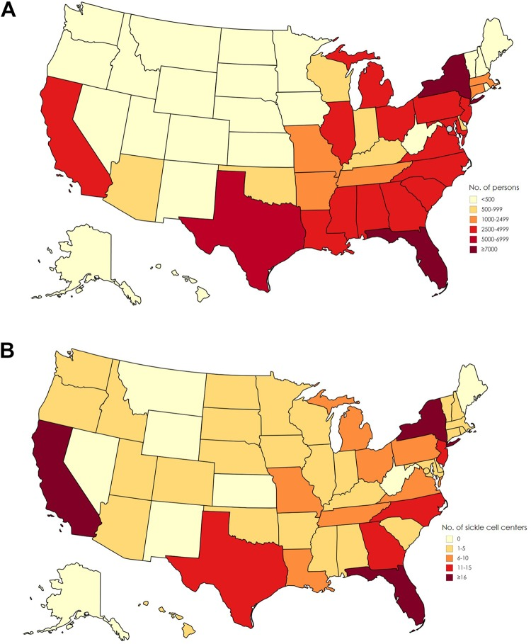
SCD prevalence in the US
Approx 100,000 people in the US living with SCD²
>90% of people in the US with SCD are Black or African American, 3-9% are Hispanic or Latino²
Large disparities in access to care: there are fewer SCD treatment centers and less money is invested in R&D for SCD relative to other, even rarer diseases such as cystic fibrosis and hemophilia³
A) Estimated number of persons with sickle cell disease, based on state-specific African American and Hispanic birth-cohort disease prevalence and 2008 US Census population, corrected for early mortality. Map previously published by Hassell¹ and reprinted with permission from the American College of Preventive Medicine. (B) Number of sickle cell disease treatment centers per state, 2017. Data source: Centers for Disease Control and Prevention (CDC).¹⁷ Used with permission from CDC.
Image source: (3) Lee et al. 2019, Public Health Rep. & Haskell
Notes:
Top image: Estimated SCD prevalence in US – note unequally distributed geographically
Bottom image: SCD care centers – note how many states with a lot of people with SCD don’t have a lot of SCD care centers

Slide 8
Two gene therapies (GT) for SCD have been approved in the US¹
GT name | Manufacturer | Approved for^{4,5} | How it works | List price⁶
Lyfgenia | bluebird bio | Patients 12+ years old with SCD and history of vaso-occlusive events (VOEs) | Inserts a working hemoglobin gene into patients’ bone marrow cells | $3.1 million
Casgevy | Vertex Pharmaceuticals | Patients 2+ years old with SCD, recurrent vaso-occlusive crises (VOCs) and transfusion-dependent ß-thalassemia (TDT) | Acts like a genetic stimulation (transcription factor) of fetal hemoglobin, which doesn’t sickle | $2.2 million
Notes:
vaso-occlusive events (VOEs) -> when blood cells clump together and block oxygen flow. Can cause severe pain and hospitalization. Bad for patients and v. expensive for medical system.
Note that it was only in July 2026 that Casgevy got expanded approval for younger kids, their preliminary approval was for people 12 years old and older.
Casgevy basically edits like a genetic stimulant (transciption factor) of fetal hemoglobin to make it so we start producing levels similar of what was produced as a fetus! Fetal hemoglobin does not itself sickle and acts as a physical barrier from the sickled cells 'clumping' (polymerizing) which is what leads to pain crises and other complications of SCD
Older sickle cell medications--mainly hydoxyurea--would stimulate fetal hemoglobin production, just not at the intrinsic genetic level!

Slide 9
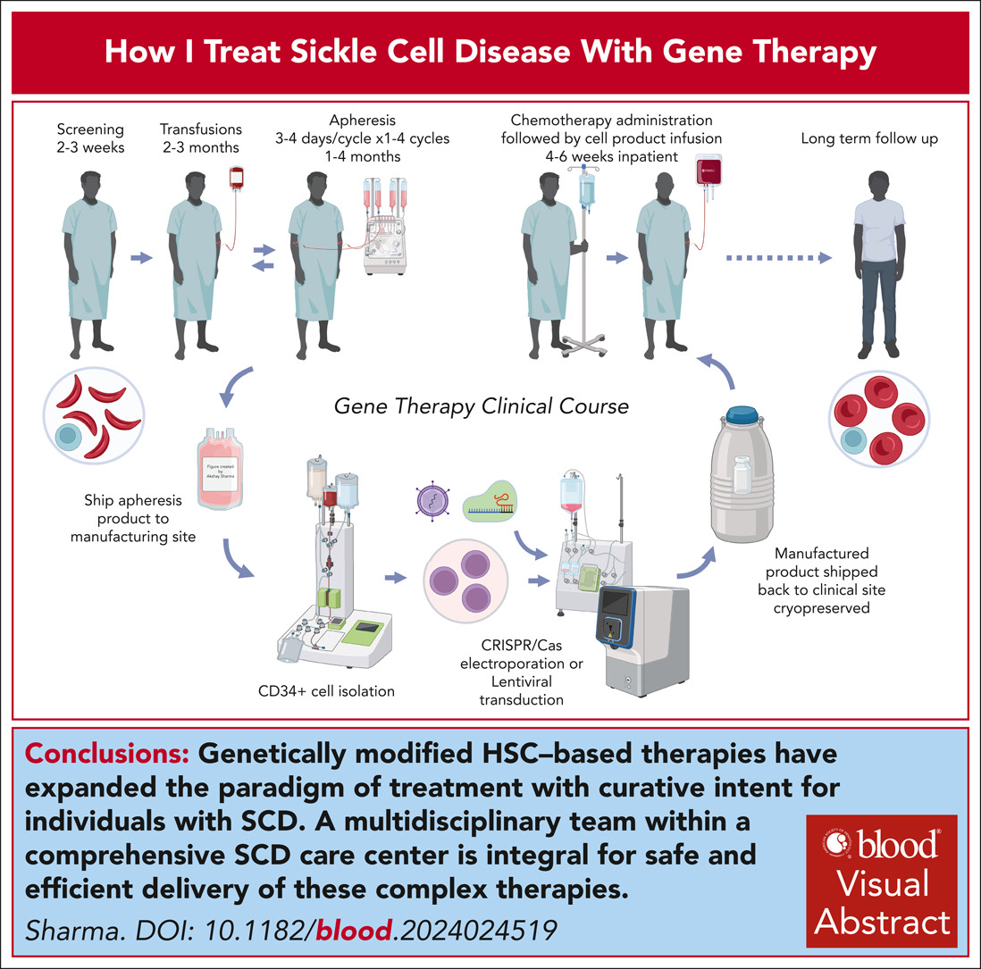
How does gene therapy for SCD work?
Patients own cells are collected, modified, and re-administered
Significant inpatient care and support services required
Chemotherapy regimen impacts patients’ fertility
Economics note: Because patient’s own cells are modified, GTs have high marginal costs
Source: (7) Sharma A. How I treat sickle cell disease with gene therapy. Blood. 2024;144(26):2693-2705. doi:10.1182/blood.2024024519
Notes:
For gene therapies, there’s also a lot of hospital care needed (weeks of inpatient stay). This adds $$ to the cost of treating patients as well (could imagine this is roughly analogous to cost of autologous transplant, est. $300k)

Slide 10
Sickle cell costs in the US: current state
Of the ~100,000 people with sickle cell in the US
  Over 50% have health insurance coverage through Medicaid or CHIP (Children’s Health Insurance Program)⁸
  1/3 have commercial insurance coverage¹⁰
Estimated lifetime costs for a person with sickle cell: $1.7 million per person, with $44k paid out of pocket⁹
> 50% Medicaid coverage
(SCD)
~ 19% Medicaid coverage
(US pop)¹¹

Slide 11
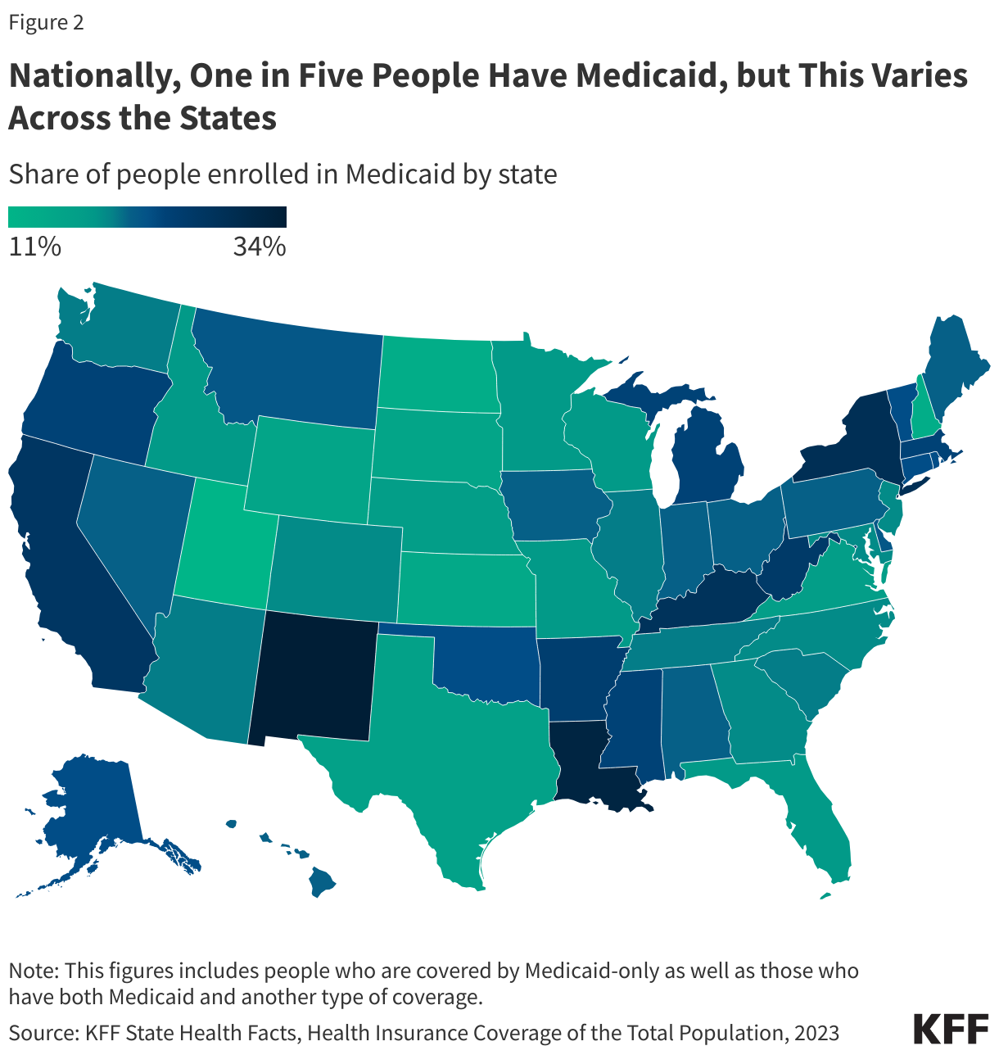
Medicaid provides health insurance for low-income Americans
Medicaid is a program that provides health insurance to low-income people in the US
Medicaid is funded by a combination of state and federal dollars¹⁰
States have a lot of flexibility in deciding who to cover and which services to provide
Individuals with SCD are disproportionately covered by Medicaid (~50%)⁸
Source for images and content: https://www.kff.org/medicaid/health-policy-101-medicaid/?entry=table-of-contents-introduction
Notes:
In Massachusetts: 24% of people are enrolled in Medicaid
Note that we’ll talk more about Medicaid in our third unit on health reform, this is just some basic information for now
Medicaid is an entitlement program – coverage guaranteed if you meet eligibility requirements. This presents a big risk to state budgets if they set treatment eligibility requirements too generously and end up on the hook for a lot of high-cost care. (Esp. because states have to balance their budgets, can’t just borrow money if they overspend like the federal government can)

Slide 12
Agenda
Intro: Sickle Cell Disease and Cell and Gene Therapies
Group Exercise: Decide how your state will allocate gene therapies for people with Medicaid
Presentations & discussion
Access to therapies in low-resource settings / low and middle-income countries
Notes:
12:15
1:45

Slide 13
Economics is only one of many lenses needed to evaluate questions prompted by gene therapies
Economic
Clinical
What will it cost?
What are the tradeoffs?
Is it safe?
Is it effective?
What do we do?
What is fair?
Ethical

Slide 14
Your task: Decide how gene therapies for SCD will be allocated to Medicaid enrollees in your state
Who will be eligible to receive SCD GT?
  Most generous: Anyone who meets FDA approval criteria can receive
  Least generous: No one gets access
  Can pick any option along this spectrum
Who will be prioritized and why?
  Each year, assume only 10 people max can access gene therapy for SCD in your state. How will you decide who gets priority?
  Example allocation strategies (non-exhaustive):
    First come, first served
    Priority to sickest
    Priority to youngest
    Random lottery
Everyone will have 10 minutes to deliberate, and 3-4 minutes to present it to the class and answer questions.
Notes:
Introduce plot twist ~12:27; 1:57
Note to TF: You can pre-assign states, or allow groups to pick their own (pre-assignment might be faster)
Remember in lecture, when Prof. Cutler asked about giving a child with spinal muscular atrophy access to a life-saving cure, everyone was for it? And remember how he said he wasn’t going to be mean and ask you to decide who got access when there wasn’t enough of the treatment for everyone? Well, today we are asking you to decide exactly that.
Re the cap on who can get it per year – this is a simplification based on the fact that the manufacturers are still ramping up their capacities, and the fact that you need specialized hospital care for a long time to receive therapy. In reality, some states might be able to treat more patients that this, and some will treat fewer. But for today, assume 10 as a rough estimate.
Note that this means that even groups who think their state should fund GT for everyone who wants it must decide who will get access first and who will have to wait.

Slide 15
PLOT TWIST! (+ you get 5 more minutes to deliberate)
State | Plot Twist
Mississippi | Budget cut: fund only 1, not 3
New York | Outcomes rebate: the manufacturer refunds part of the cost if crises return
Texas | Equity complaint: nobody from the rural half of the state got treated
Georgia | Health shock: D has a stroke while waiting
Massachusetts | Fertility: A’s parents want A to wait until old enough to decide
Notes:
12:27, 1:57
Ask groups to present their original allocation decision rule and their new decision based on this plot twist

Slide 16
Each group gets 3 minutes to present + 3 minutes for Q&A
Notes:
Come back together ~12:32; 2:02
Each group gets 6 minutes: 3 min to present, 3 for questions
Remind students of their stakeholder perspective
5 groups → 1:02
4 groups → 2:26

Slide 17
Questions for discussion
Which applicants did most groups treat, and which applicants did most leave waiting? Did hearing another group’s rule make you rethink yours?
Rule of Rescue: In lecture, everyone agreed the child with SMA should get the cure. Today, would you have said yes to all 6 applicants if you could? Was it harder to say no once they had names and stories?
Efficiency vs fairness: Were you trying to get the most health out of 3 slots, or give each person a fair shot? Did cost factor in? Can one rule do both? Did you consider cost-benefit / cost-effectiveness?
Hidden bias: Did rules that seem neutral, like first-come first-serve or a lottery, end up favoring people with more resources (applicant E)?
Notes:
People find it hard to turn down an identifiable person, so they tend to fund rescues and avoid rationing.
- First come, first served looks neutral. But the people who apply first tend to be the ones who heard about gene therapy early, have a hematologist who refers them, and can handle the paperwork. Those patients tend to be urban and better resourced.
- Lottery gives everyone the same odds of winning. But winning only matters if you can actually go through treatment: a month in the hospital, a caregiver, months living near the treatment center, time off work, and fertility preservation that may not be covered. E has the same odds as everyone else and much less real access.
If two groups used different rules and picked the same people, did the rule matter? Different principles usually agree on the easy cases, so the real disagreement is over the last one or two slots.
Real Medicaid committees decide on criteria, not on life stories. Is that fairer or colder? People feel a stronger pull to save an identifiable person than to save statistical lives. Writing rules in advance protects against rewarding whoever has the most moving story, but it can feel impersonal.
Every applicant costs the same $2–3M, so cost can’t separate them. Cost decides how many slots a state funds. Who gets those slots comes down to benefit and fairness. Is “most benefit” fair to B, who is suffering the most right now?
If E wins the lottery but can’t leave home for a month, was E’s chance really equal? Who applies first under first come, first served? The fix is often support rather than re-ranking: fund travel, housing, and a caregiver. The CMS model gives states funding for support services like these. Mississippi, for example, funded a program coordinator to guide patients through treatment.
“It’s unfair that where you live decides your care.” If students defend states setting their own budgets.
That’s the trade-off of running Medicaid state by state. The CMS model reduces the differences: participating states cover about 84% of Medicaid patients with sickle cell. But patients in Georgia and Massachusetts are outside the model.

Slide 18
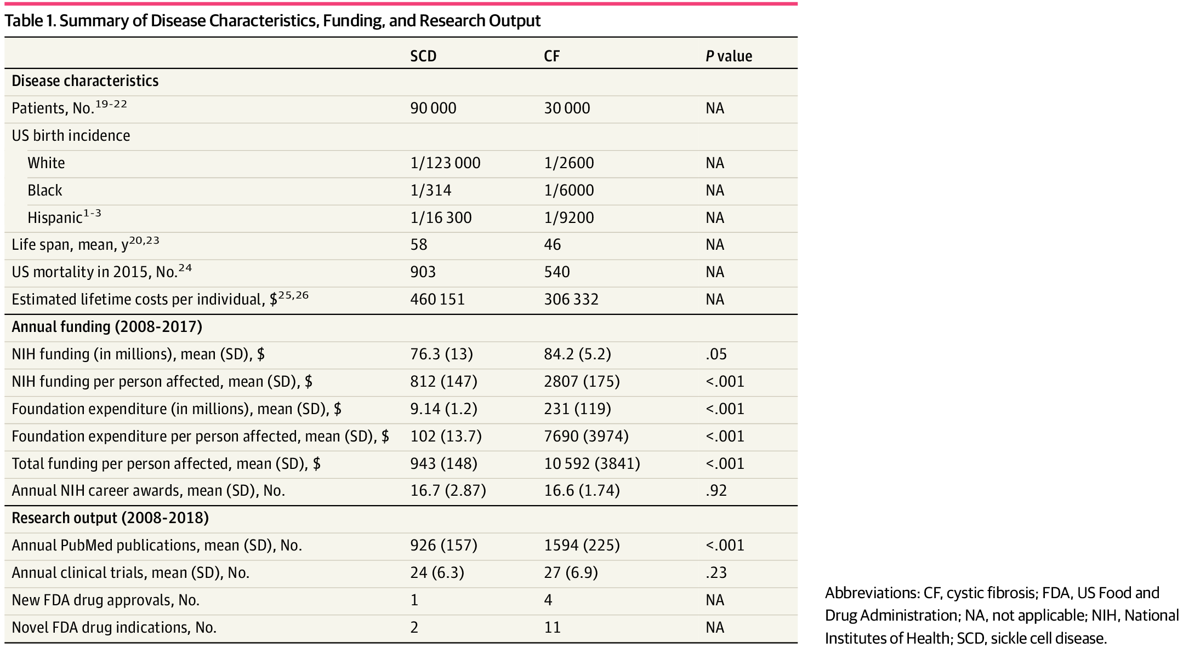
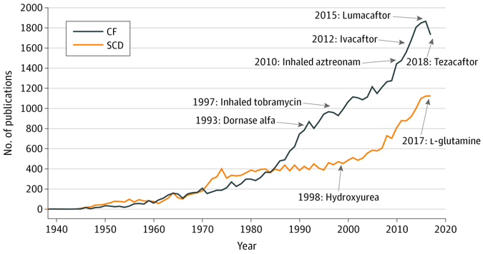
A note on health disparities: SCD and cystic fibrosis¹²
Figure 1. Number of Disease-Specific PubMed Listings and US Food and Drug Administration Drug Approvals Over Time
From: Comparison of US Federal and Foundation Funding of Research for Sickle Cell Disease and Cystic Fibrosis and Factors Associated With Research Productivity
JAMA Netw Open. 2020;3(3):e201737. doi:10.1001/jamanetworkopen.2020.1737
Notes:
CF is about 1/3 as common in the US as SCD, yet it has received significantly more disease-specific private foundation research spending -> more publications, more treatment approvals
Note that GT not on this graph (as the paper is from 2020).
CF drugs are also very high priced, but patient groups have been very successful in getting them covered, even in the UK, where NICE originally said they wouldn’t cover the drugs b/c they were not cost effective https://www.fiercepharma.com/pharma/vertex-clinches-trikafta-and-other-cystic-fibrosis-drug-reimbursement-deal-England

Slide 19
Agenda
Intro: Sickle Cell Disease and Cell and Gene Therapies
Group Exercise: Decide how your state will allocate gene therapies for people with Medicaid
Presentations & discussion
Access to therapies in low-resource settings / low and middle-income countries

Slide 20
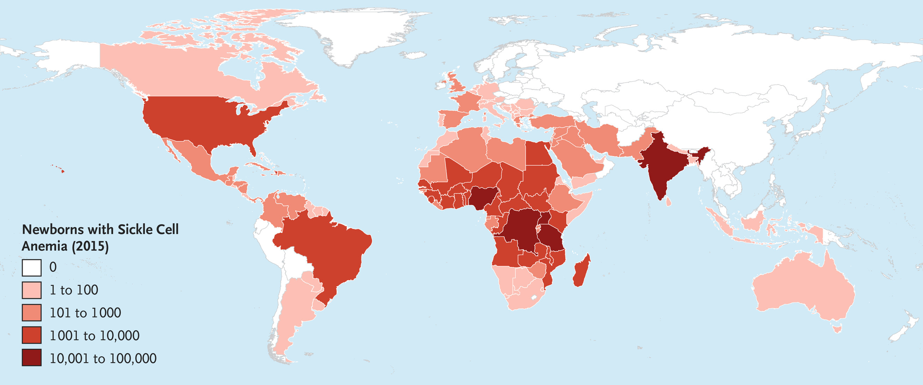
SCD affects people worldwide – can/should we expand gene therapy access worldwide?
Global incidence of sickle cell anemia (severe sub-type of SCD)
Image source: (13) Piel et al. 2017, NEJM
Notes:
Question for class – what do you think? Is it just that people in rich countries have access to newer, more expensive treatments than people in poor and middle-income countries?
If we don’t think this state of the world is just, whose responsibility is it to do something about that?

Slide 21
Could any of the strategies from Tuesday’s video help get SCD treatments to LMICs?
Not-for-profit research
Advance market commitments
Patent buyout
Priority review vouchers
Notes:
Ask students to define each strategy (should have learned this in the video for Tuesday’s class)
Could any of these strategies work for gene therapies? Other SCD treatments? Give 2-3 min to discuss with neighbor, then ask them to share with class
Key takeaways hoping we’ll get at: these strategies are largely trying to push costs for LMICs down to MC. However, if MC is high (as in GTs), this may still be unaffordable

Slide 22
Could any of the strategies from Tuesday’s video help get SCD treatments to LMICs?
Not-for-profit research
Advance market commitments
Patent buyout
Priority review vouchers
Maybe, but still need to consider:
GTs have high marginal costs. Even if we get prices for LMICs down to MC, they may still be unaffordable.
Lots of high-intensity support services needed for GT (chemo, hospital stay, SCD specialists, etc.). These would also need to be built up in LMICs (and in lower resourced areas of the US!) for people to have meaningful access to GTs.

Slide 23
Upcoming
Thursday, Oct 15: meet with Unit 2 project team in lecture
Friday, October 23: Unit 2 assignment due

Slide 24
Sources
What Is Sickle Cell Disease? Cleveland Clinic. Accessed October 9, 2026. https://my.clevelandclinic.org/health/diseases/12100-sickle-cell-disease
CDC. Data and Statistics on Sickle Cell Disease. Sickle Cell Disease (SCD). August 21, 2026. Accessed October 9, 2026. https://www.cdc.gov/sickle-cell/data/index.html
Lee L, Smith-Whitley K, Banks S, Puckrein G. Reducing Health Care Disparities in Sickle Cell Disease: A Review. Public Health Rep. 2019;134(6):599-607. doi:10.1177/0033354919881438
LYFGENIA. FDA. Published online July 10, 2024. Accessed October 9, 2026. https://www.fda.gov/vaccines-blood-biologics/lyfgenia
CASGEVY. FDA. Published online July 8, 2026. Accessed October 9, 2026. https://www.fda.gov/vaccines-blood-biologics/casgevy
Pricey new gene therapies for sickle cell pose access test | BioPharma Dive. Accessed October 9, 2026. https://www.biopharmadive.com/news/crispr-sickle-cell-price-millions-gene-therapy-vertex-bluebird/702066/
Sharma A. How I treat sickle cell disease with gene therapy. Blood. 2024;144(26):2693-2705. doi:10.1182/blood.2024024519
Improving Care for Sickle Cell Disease | Medicaid. Accessed August 27, 2024. https://www.medicaid.gov/medicaid/quality-of-care/quality-improvement-initiatives/improving-care-for-sickle-cell-disease/index.html
Johnson KM, Jiao B, Ramsey SD, Bender MA, Devine B, Basu A. Lifetime medical costs attributable to sickle cell disease among nonelderly individuals with commercial insurance. Blood Adv. 2022;7(3):365-374. doi:10.1182/bloodadvances.2021006281
Health Insurance Coverage in the United States: 2022. U.S. Census Bureau. https://www.census.gov/library/publications/2023/demo/p60-281.html
How Has Medicaid Evolved Over Time? - Medicaid 101. KFF. October 3, 2025. Accessed October 9, 2026. https://www.kff.org/medicaid/health-policy-101-medicaid/?entry=table-of-contents-how-has-medicaid-evolved-over-time
Farooq F, Mogayzel PJ, Lanzkron S, Haywood C, Strouse JJ. Comparison of US Federal and Foundation Funding of Research for Sickle Cell Disease and Cystic Fibrosis and Factors Associated With Research Productivity. JAMA Netw Open. 2020;3(3):e201737. doi:10.1001/jamanetworkopen.2020.1737
Piel FB, Steinberg MH, Rees DC. Sickle Cell Disease. New England Journal of Medicine. 2017;376(16):1561-1573. doi:10.1056/NEJMra1510865

